Slide 1
Measurement of Biodiversity (MoB) framework
Multiscale analysis
Two-scale analysis
Slides adopted from Dan McGlinn

Slide 2

Scale-dependent and multidimensional nature of biodiversity
Components underlying species richness:
Quadrat area (scale)
Density of individuals
Size and evenness of the regional species pool
Intraspecific spatial aggregation

Slide 3
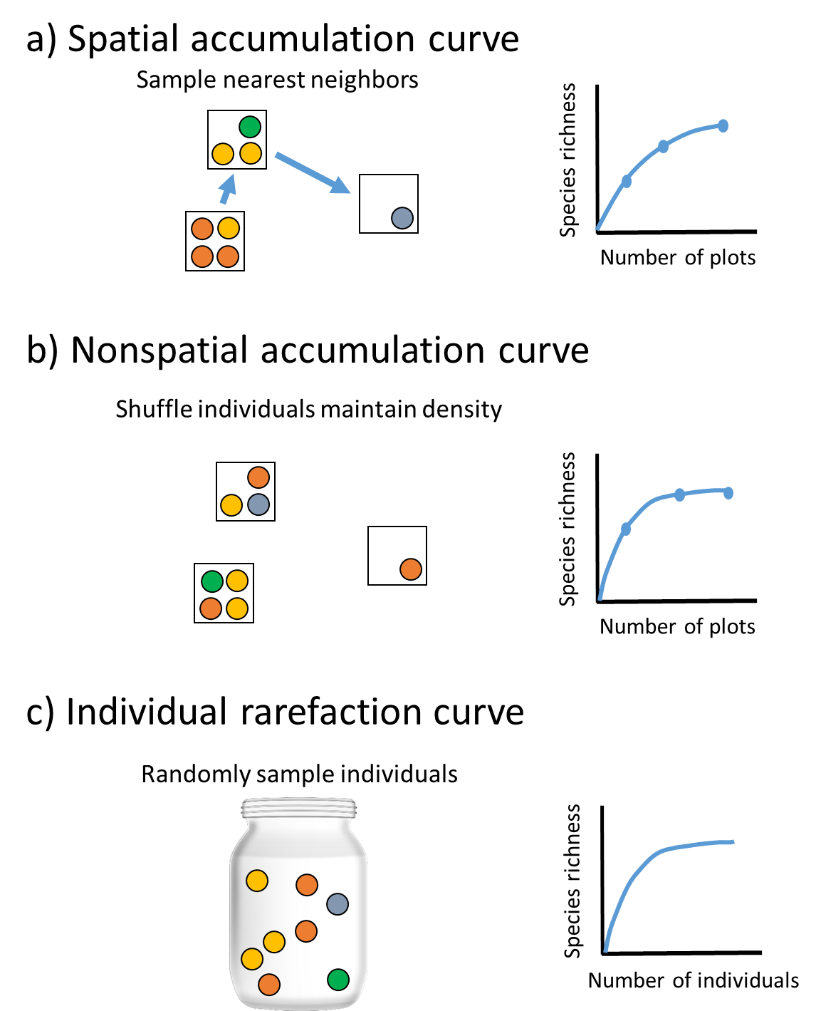

Where is the complexity lost?
 | Sp 1 | Sp 2 | Sp 3 | Sp 4
Sample 1 | 5 | 7 | 2 | 1
Sample 2 | 1 | 1 | 4 | 15
Sample 3 | 0 | 5 | 4 | 1
Sample 4 | 20 | 2 | 4 | 0
Single scale richness estimate
Reality
We know about N, SAD, intraspecific spatial aggregation and scale.
MoB
Quadrats
Information
Community
matrix
Accumulation
curves
Richness estimate
Sampling and data processing

Slide 4
Spatial, plot-based accumulation
Non-spatial, plot-based rarefaction
Individual-based rarefaction

Slide 5
Nested Information
Spatial Curve
Aggregation
Nonspatial Curve
Density of Individuals
Rarefaction curve
Rarity &
Size of pool

Slide 6
Three types of Collector Curves
Spatial
sample-based
Depends on
SAD
Density of Individuals (N)
Intraspecific spatial aggregation (Agg.)
Collect nearby samples first,
do not shuffle individuals.

Slide 7
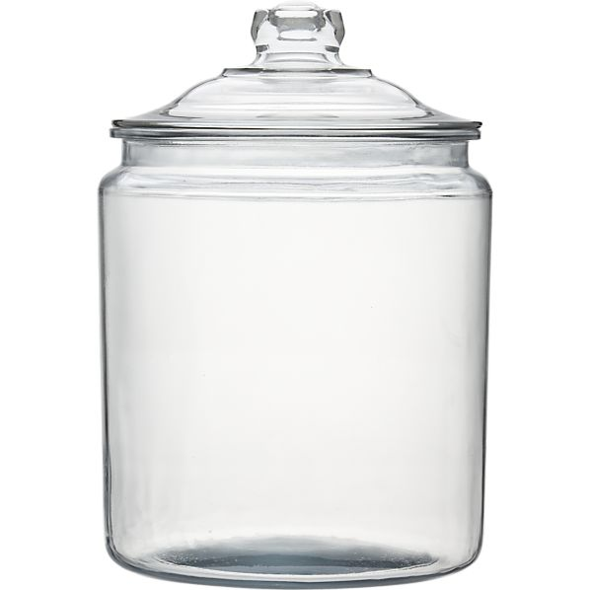
Three types of Collector Curves
Non-spatial,
sample-based
Depends on
SAD
Density of Individuals (N)
Randomly draw individuals
into samples
based on observed density

Slide 8
Three types of Collector Curves
Individual-based,
spatially random
Depends on
Species Abundance Distribution (SAD)
commonness & rarity, size of species pool
frequency
Randomly draw
individuals
abundance

Slide 9
Scale-dependent components as difference of curves
IBR
nsSBR
sSBR
Species richness (S)
N effect
Aggregation effect
SAD effect
Sampling effort
(# plots or # individuals)

Slide 10
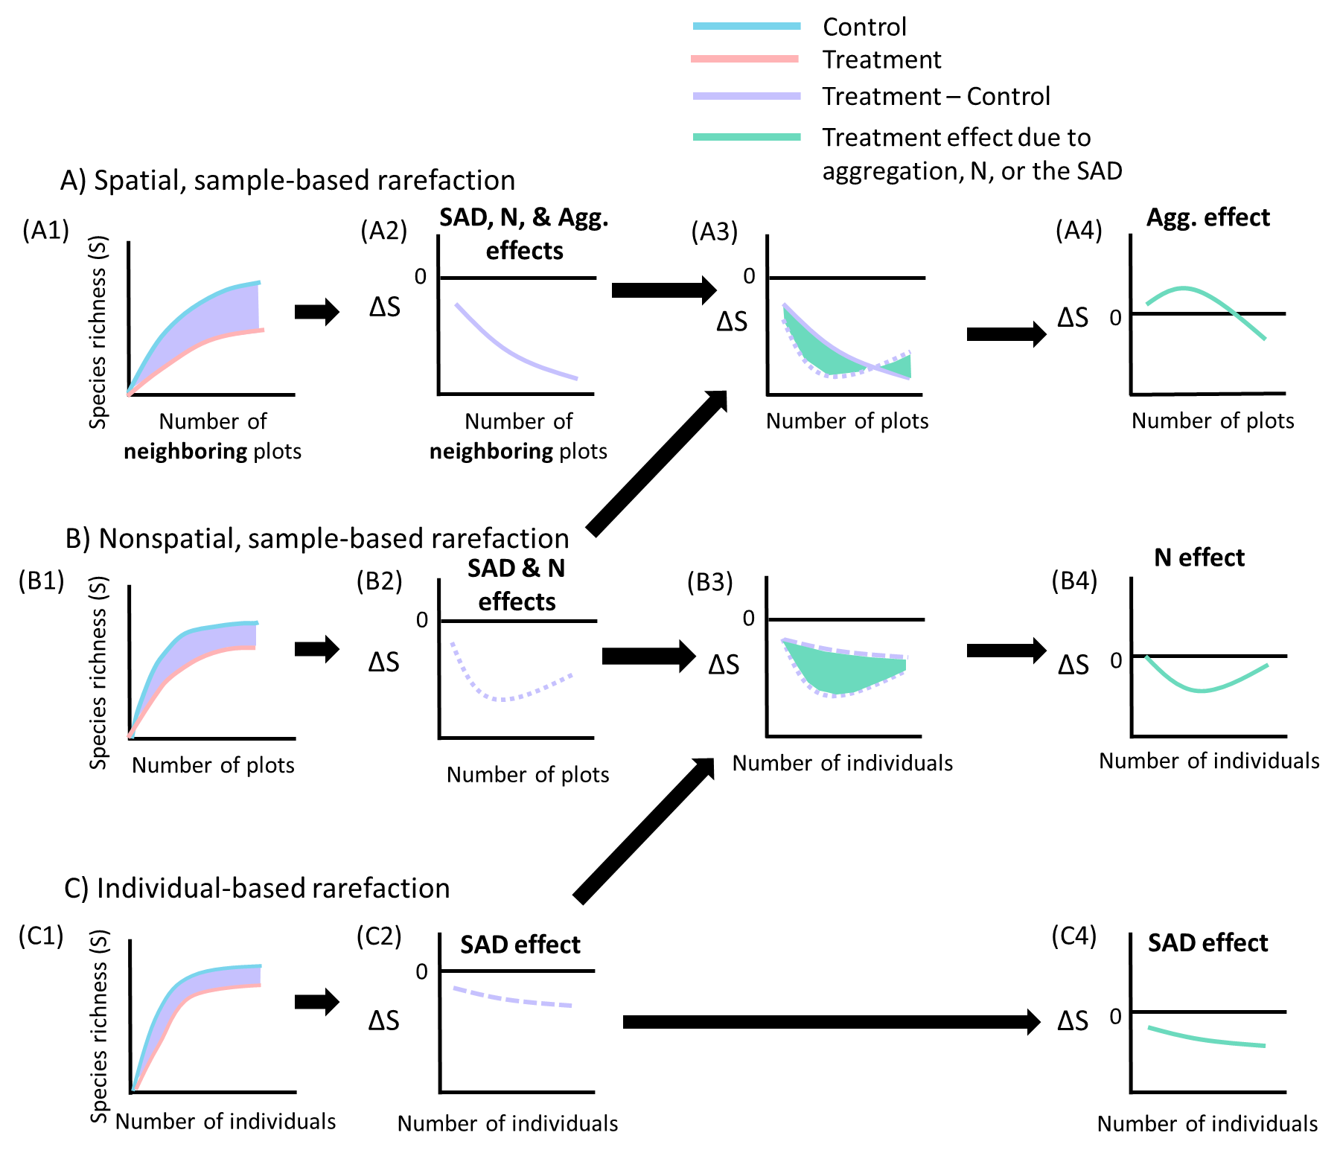

Slide 11
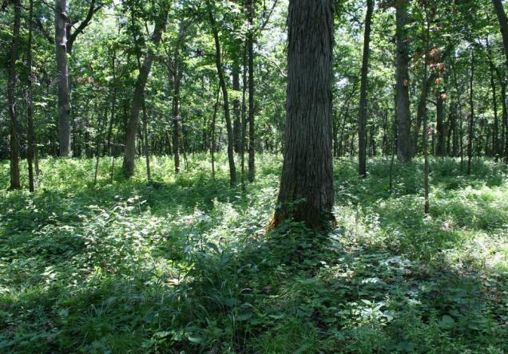
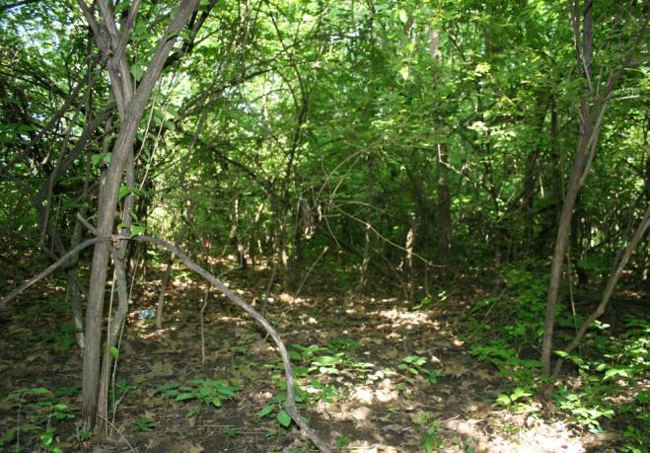
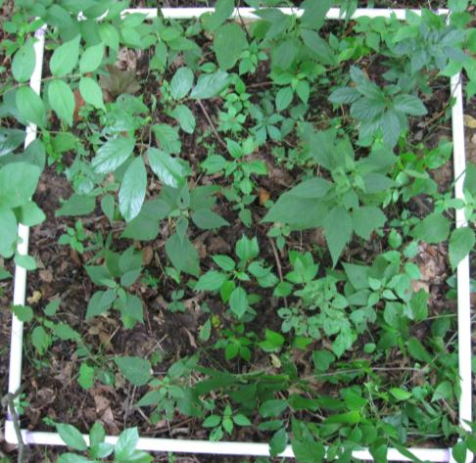
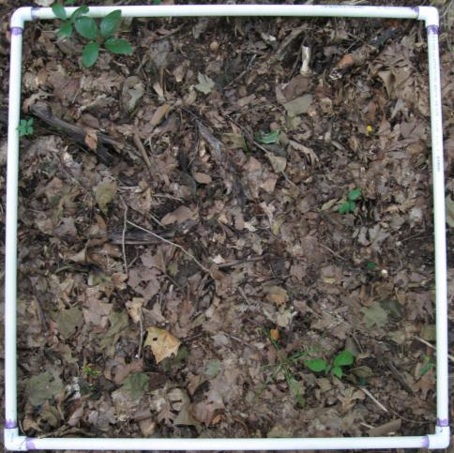
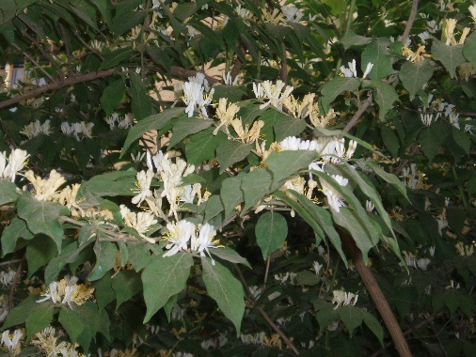
Case Study: How does invasion effect diversity?
Uninvaded
Invaded by Lonicera maackii
50 samples in invaded and uninvaded plots
Powell et al. 2013
Notes:
Lonicera maackii

Slide 12
Traditional Analysis

Slide 13
Invasion decreased density

Slide 14
Collector Curves
invaded
uninvaded
Spatial
Non-spatial
Individual

Slide 15
Change in S
invaded
uninvaded
Spatial
Non-spatial
Individual

Slide 16
Change in S
invaded
uninvaded
Spatial
Non-spatial
Individual

Slide 17
Change in S
invaded
uninvaded
Spatial
Non-spatial
Individual
Reflect treatment effects on …
SAD, N, &
Agg.
SAD & N
SAD

Slide 18
Spatial
Non-spatial
Individual
Aggregation effect
Null Model Prediction

Slide 19
Spatial
Non-spatial
Individual
Density effect

Slide 20
Spatial
Non-spatial
Individual
SAD effect

Slide 21
Spatial
Non-spatial
Individual

Slide 22
Aggregation
Density
SAD
Number of Individuals
Number of Individuals
Change in Richness
Proportion of effect
Number of Samples
Number of Samples

Slide 23
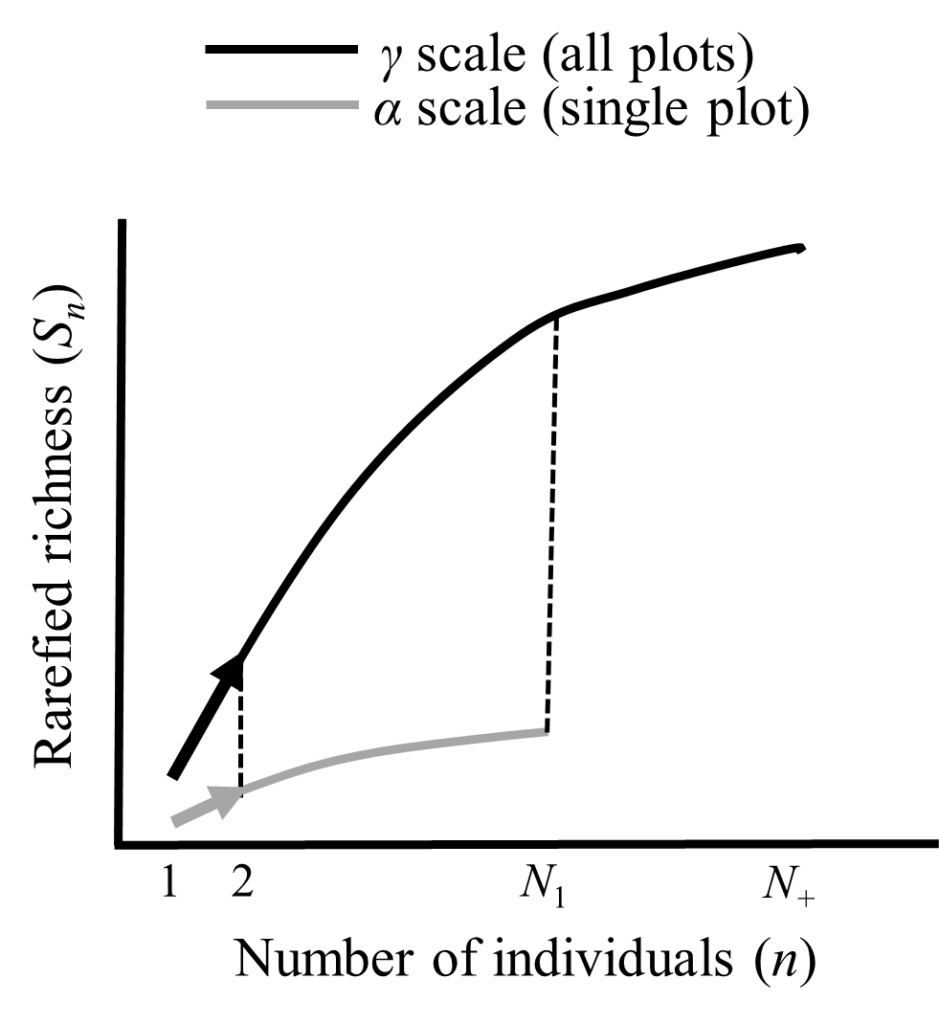
If that was too much scale for you, take the multi-metric two-scale approach…
Two scales
SAD
Metrics
S observed
N
S_n
S_PIE
Aggregation
Individuals

Slide 24
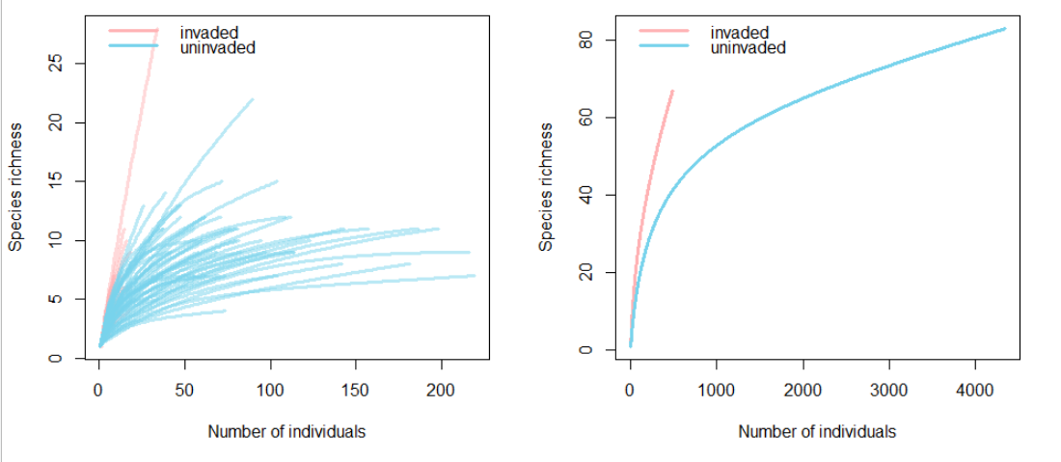
Invaded plots have higher evenness and decreased abundance
Decrease in S_obs and N; increase in S_n and S_PIE
There is loss and gain of diversity at the same time!

Slide 25
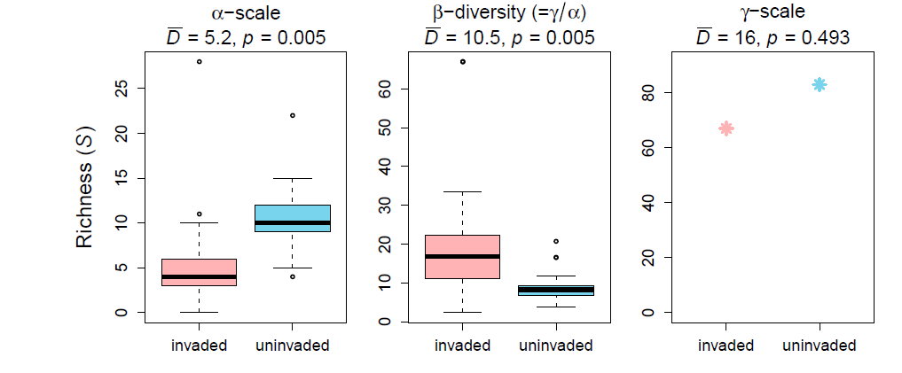
This is what we saw before

Slide 26
Invasion decreased density

Slide 27
Change in density influences S

Slide 28
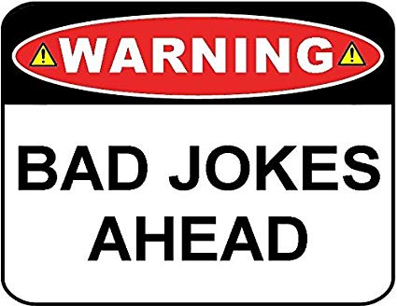

Slide 29
The party of the accumulation curves
The three types of accumulation curves are at a Party and the mob is going crazy:
The spatial sample-based accumulation curve is all over the dancefloor, dancing from one person to the next in a fancy choreography. Also the nonspatial sample-based accumulation curve is dancing its crazy shuffle moves. Only the individual-based rarefaction curve is randomly wandering across the dancefloor and crying.
Someone : “What’s up with you, IBR?”
IBR, sobbing: “I don’t know. Somehow everything I see is SAD.”

Slide 30
Summary
The full mob approach is elegant but more complex and more data hungry
The multi-metric approach is appropriate when you don’t have spatial information and just one or two scales.
Species richness is a close to meaningless summery statistic
Whenever possible try to think about N, SAD and intraspecific spatial aggregation
Further reading:
McGlinn, D. J., Xiao, X., May, F., Gotelli, N. J., Engel, T., Blowes, S. A., … McGill, B. J. (2018). MoB (Measurement of Biodiversity): a method to separate the scale-dependent effects of species abundance distribution, density, and aggregation on diversity change. Methods in Ecology and Evolution, 2018(September), 244103. https://doi.org/10.1111/2041-210X.13102
Chase, J. M., McGill, B. J., McGlinn, D. J., May, F., Blowes, S. A., Xiao, X., … Gotelli, N. J. (2018). Embracing scale-dependence to achieve a deeper understanding of biodiversity and its change across communities. Ecology Letters, 21(11), 1737–1751. https://doi.org/10.1111/ele.13151
Examples, code, vignettes: https://github.com/MoBiodiv/mobr

